Slide 1
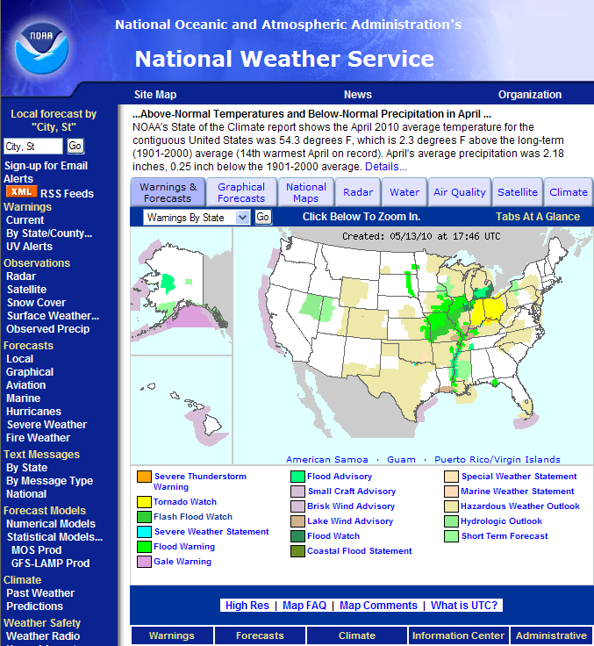
National Weather Service Products on the Internet
Erik Heden
Meteorologist
NWS Weather Forecast Office Binghamton, NY
Patti Wnek
Service Coordination Hydrologist
NWS Middle Atlantic River Forecast Center
Notes:
The purpose of our talk is to tell you about some useful products on the National Weather Service website that are helpful to understand your vulnerability to flood at any given day.
A handout is available with a list of all of the addresses for the products we will be showing you.

Slide 2
Watches/Warnings
- Map will highlight based on any active watches or warnings that are in effect
By clicking on your area of interest, you can view any valid watches or warnings that are in effect
Notes:
Watch and warning products that are issued by the National Weather Service appear on the local map to give a graphical representation of the hazard. Using the legend at the right, you can visually see what each product is.
The purpose of our talk is to tell you about some useful products on the National Weather Service website that are helpful to understand your vulnerability to flood at any given day.
A handout is available with a list of all of the addresses for the products we will be showing you.

Slide 3
Watches/Warnings
- Map will highlight based on any active watches or warnings that are in effect
By clicking on your area of interest, you can view any valid watches or warnings that are in effect
Notes:
Notice the different colors on this map. A flash flood warning, flash flood watch, flood warning, and flood advisory are all products that are currently in effect at this time.
The purpose of our talk is to tell you about some useful products on the National Weather Service website that are helpful to understand your vulnerability to flood at any given day.
A handout is available with a list of all of the addresses for the products we will be showing you.

Slide 4
Watches/Warnings
- Map will highlight based on any active watches or warnings that are in effect
By clicking on your area of interest, you can view any valid watches or warnings that are in effect
Notes:
If you have a particular area of interest, such as where you live or work, you can click on the map itself for more information. For instance, let’s say you live in Tupelo, MS. Click on the map.
The purpose of our talk is to tell you about some useful products on the National Weather Service website that are helpful to understand your vulnerability to flood at any given day.
A handout is available with a list of all of the addresses for the products we will be showing you.

Slide 5
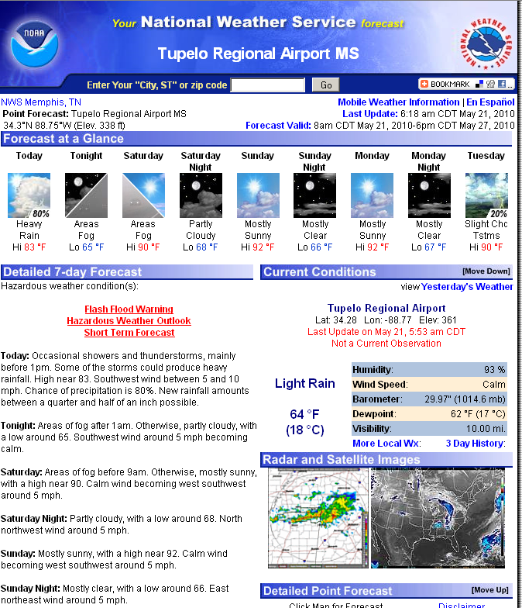
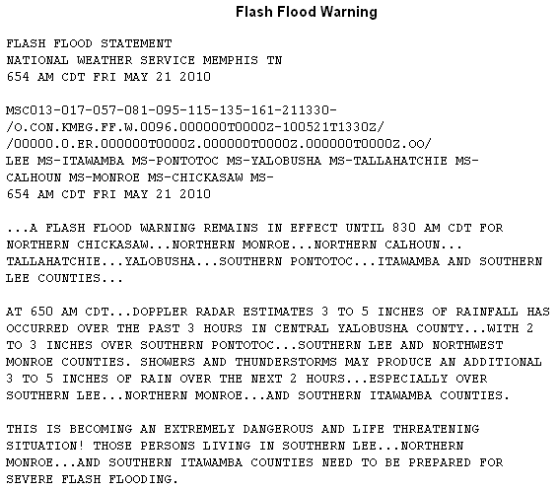
Watches/Warnings
Notes:
The forecast for Tupelo will come up (left), along with the Flash Flood Warning link near the top (in red). By clicking on this link, you will see the actual text for the flash flood warning (right).
The purpose of our talk is to tell you about some useful products on the National Weather Service website that are helpful to understand your vulnerability to flood at any given day.
A handout is available with a list of all of the addresses for the products we will be showing you.

Slide 6
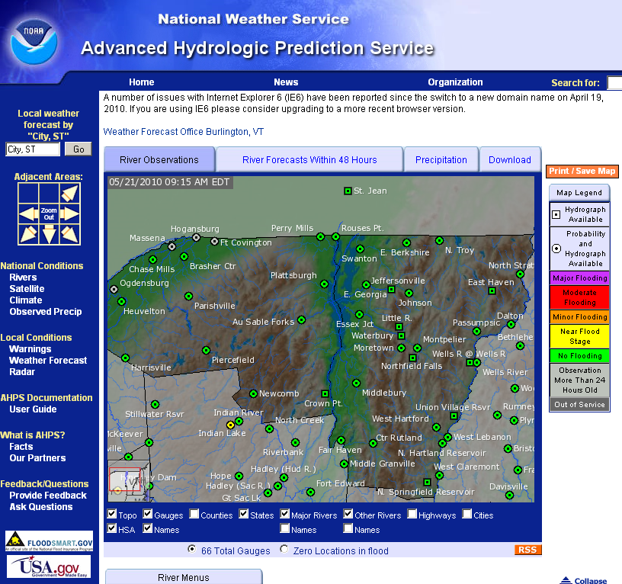
AHPS
River levels, both past, present and future
Specific site information, including gauge location, history, and flood category
Precipitation amounts, including observed and departure from normal.
Notes:
Advanced Hydrologic Prediction Services (AHPS) has many sources of data that are useful. Everything from past/current/future river stages to observed precipitation and precipitation departures can be viewed through AHPS. By clicking on a specific point on this map,
The purpose of our talk is to tell you about some useful products on the National Weather Service website that are helpful to understand your vulnerability to flood at any given day.
A handout is available with a list of all of the addresses for the products we will be showing you.

Slide 7
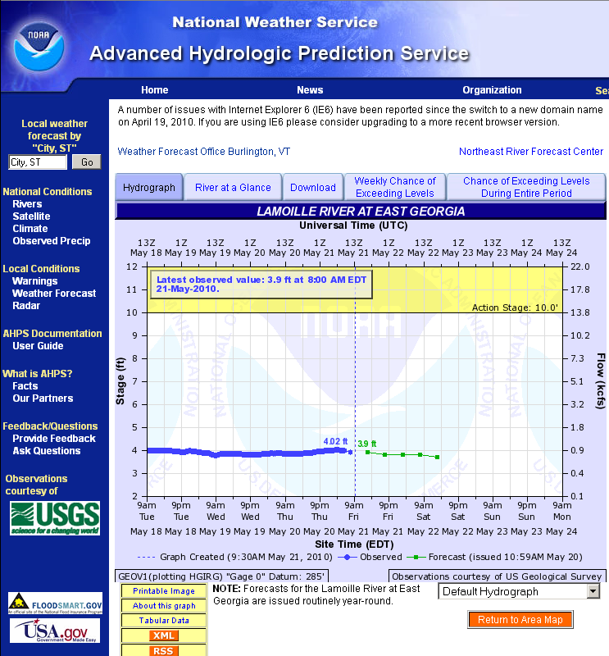
AHPS
- Forecast for the river (green)
- Quick view of the trend of the river (blue)
- Flood category will be graphed as applicable
Notes:
You can view the hydrograph for the river at this point. This will display the trend of the river, the current stage, and the forecast for the next few days. Other information such as historical crests, the location of the gauge, and the chance of exceeding levels can be found on this page.
The purpose of our talk is to tell you about some useful products on the National Weather Service website that are helpful to understand your vulnerability to flood at any given day.
A handout is available with a list of all of the addresses for the products we will be showing you.

Slide 8
AHPS
- Forecast for the river (green)
- Quick view of the trend of the river (blue)
- Flood category will be graphed as applicable
Notes:
Introductions –
The purpose of our talk is to tell you about some useful products on the National Weather Service website that are helpful to understand your vulnerability to flood at any given day.
A handout is available with a list of all of the addresses for the products we will be showing you.

Slide 9
AHPS
- Forecast for the river (green)
- Quick view of the trend of the river (blue)
- Flood category will be graphed as applicable
Notes:
Introductions –
The purpose of our talk is to tell you about some useful products on the National Weather Service website that are helpful to understand your vulnerability to flood at any given day.
A handout is available with a list of all of the addresses for the products we will be showing you.

Slide 10
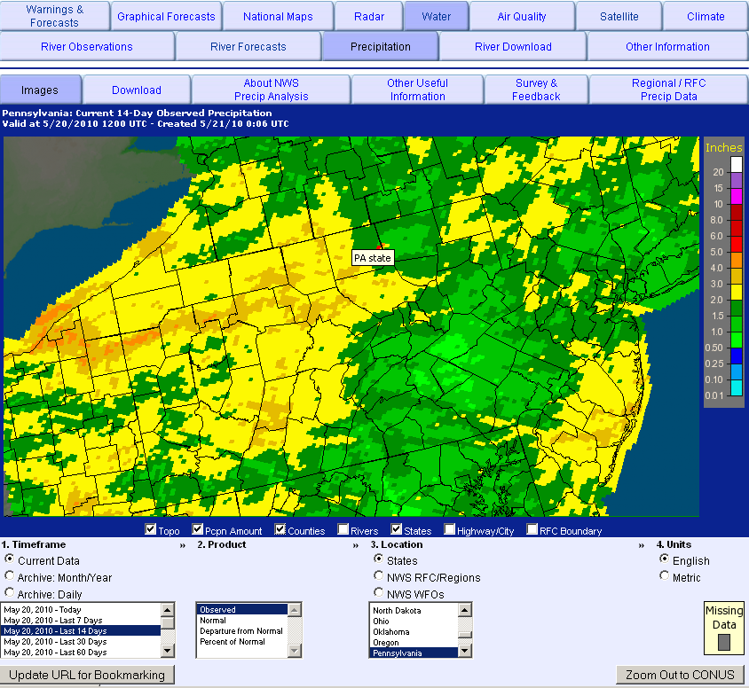
AHPS
Observed Precipitation
- Quickly view maximum and minimums in rainfall
- Data intervals can be as little as a day or a week, or up to 180 days.
- Data can be downloaded
Notes:
This map can be useful to identify areas that see the heaviest or the lightest amounts of precipitation. You can view this data over a day, a week, or up to 180 days. This data can also be downloaded.

Slide 11
AHPS
Observed Precipitation
- Quickly view maximum and minimums in rainfall
- Data intervals can be as little as a day or a week, or up to 180 days.
- Data can be downloaded
Notes:
This map can be useful to identify areas that see the heaviest or the lightest amounts of precipitation. You can view this data over a day, a week, or up to 180 days. This data can also be downloaded.

Slide 12
AHPS
Observed Precipitation
- Quickly view maximum and minimums in rainfall
- Data intervals can be as little as a day or a week, or up to 180 days.
- Data can be downloaded
Notes:
This is where you would change your interval for the data.
The purpose of our talk is to tell you about some useful products on the National Weather Service website that are helpful to understand your vulnerability to flood at any given day.
A handout is available with a list of all of the addresses for the products we will be showing you.

Slide 13
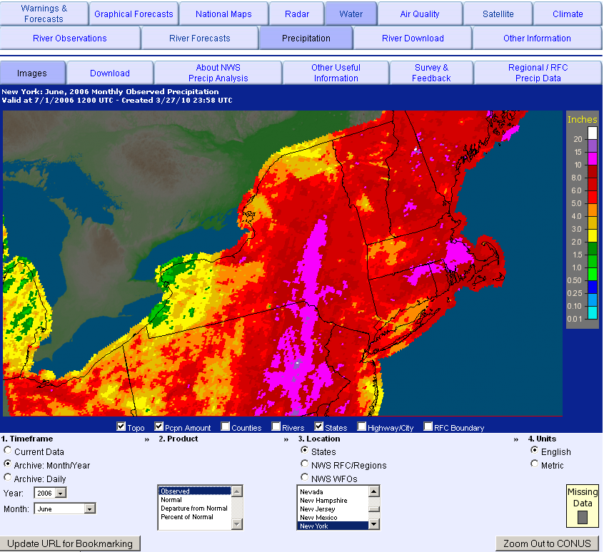
AHPS
Observed Precipitation
- Archive data goes back to 2005
- Useful for historic events (June 2006)
- Monthly archive data includes departure from normal and percent of normal
- Daily archive data only includes observed
Notes:
If you want to go farther back than 180 days, you can change the timeframe to archive mode. This will allow you to view data back to 2005. This is helpful for historic events.
The purpose of our talk is to tell you about some useful products on the National Weather Service website that are helpful to understand your vulnerability to flood at any given day.
A handout is available with a list of all of the addresses for the products we will be showing you.

Slide 14
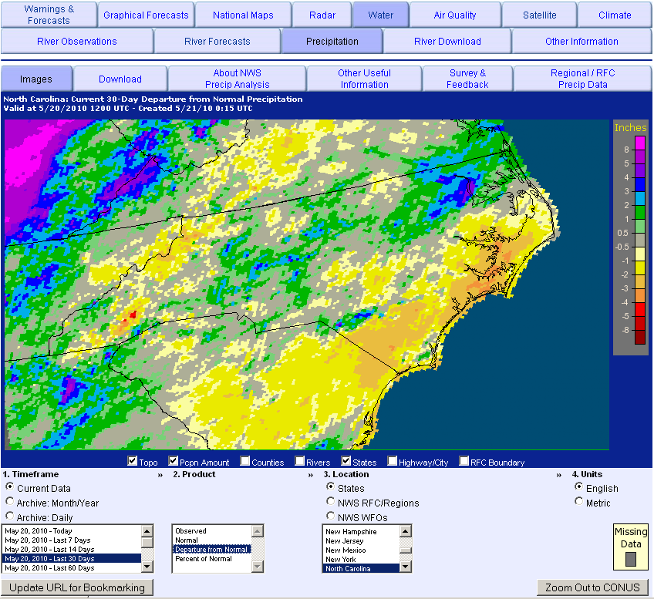
AHPS
Departure from Normal
- Similar to the observed precipitation, this data can be downloaded, viewed, etc.
Notes:
In addition to observed precipitation, you can view departures from normal. Much like with observed precipitation, you have many options on how to view this data.
The purpose of our talk is to tell you about some useful products on the National Weather Service website that are helpful to understand your vulnerability to flood at any given day.
A handout is available with a list of all of the addresses for the products we will be showing you.

Slide 15
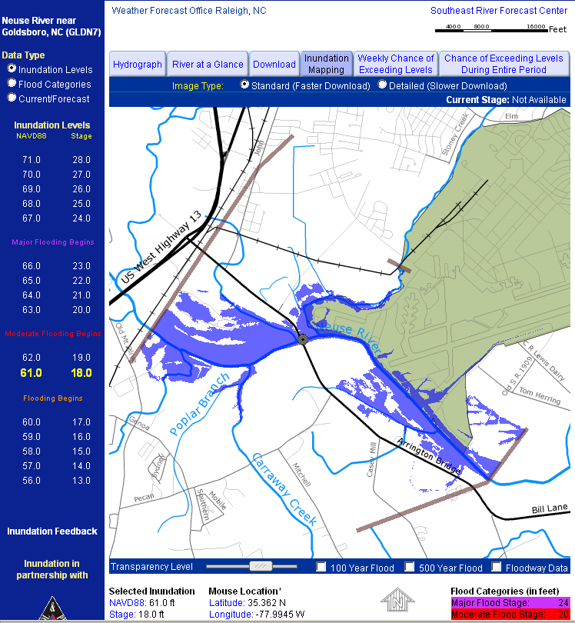
Inundation Mapping
- On the left hand side by scrolling up to “raise” the level of the river
Notes:
Inundation mapping provides a visual representation of what areas may flood based on the level of the river.
The purpose of our talk is to tell you about some useful products on the National Weather Service website that are helpful to understand your vulnerability to flood at any given day.
A handout is available with a list of all of the addresses for the products we will be showing you.

Slide 16
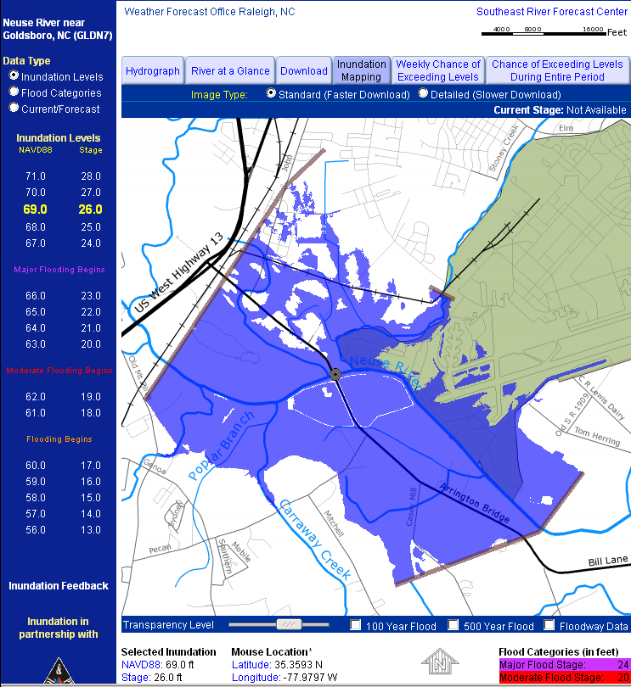
Inundation Mapping
- You can view what areas are predicted to be inundated at that stage.
Notes:
Introductions –
The purpose of our talk is to tell you about some useful products on the National Weather Service website that are helpful to understand your vulnerability to flood at any given day.
A handout is available with a list of all of the addresses for the products we will be showing you.

Slide 17
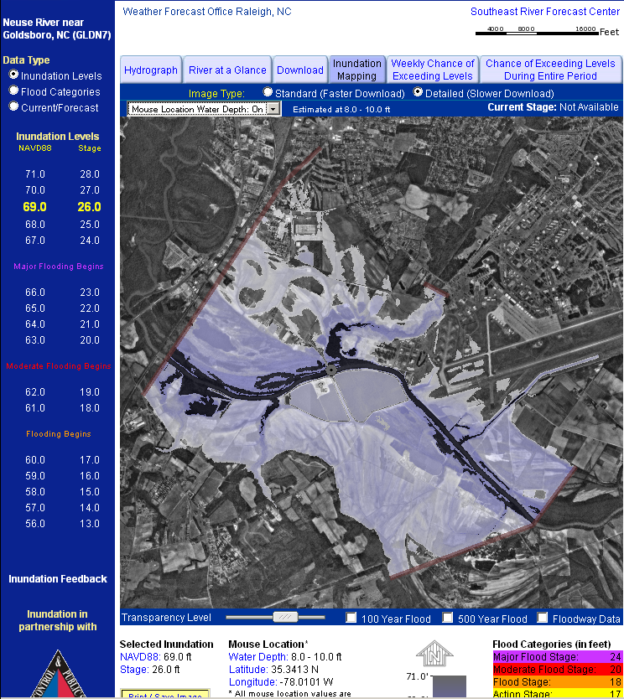
Inundation Mapping
- Detailed version will show you the depth of the water
Notes:
Introductions –
The purpose of our talk is to tell you about some useful products on the National Weather Service website that are helpful to understand your vulnerability to flood at any given day.
A handout is available with a list of all of the addresses for the products we will be showing you.

Slide 18
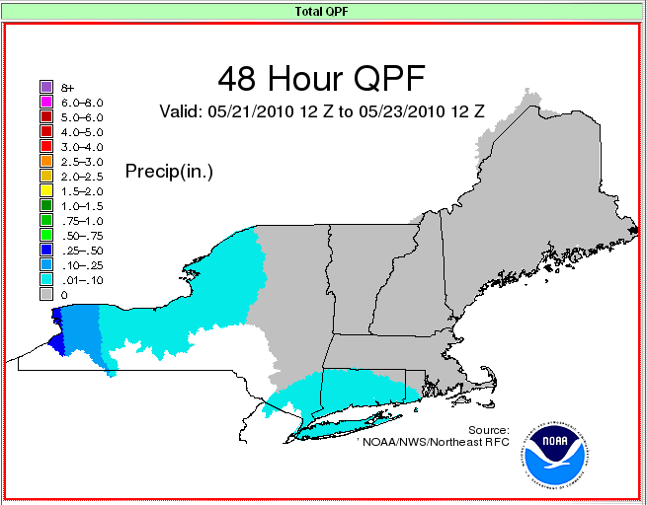
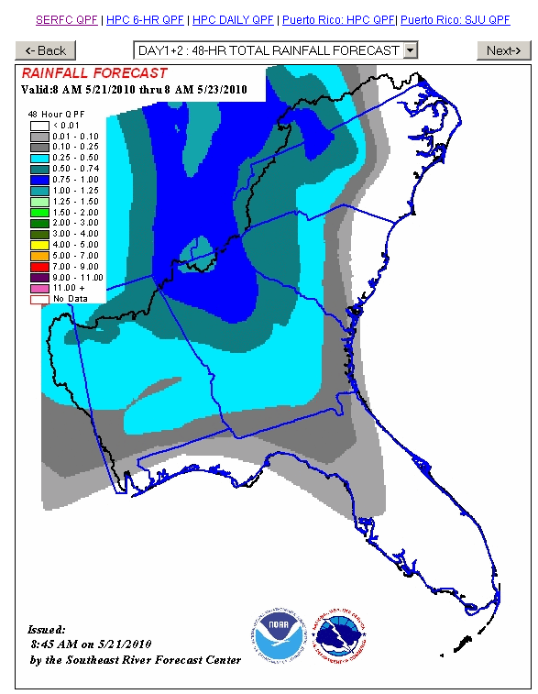
Precipitation Forecasts (QPF)
Basis for river model forecast
Formats may vary from River Forecast Center, but you can view expected precipitation amounts out to 48 hours.
Notes:
To gain a better understanding of the amount of precipitation that is expected in the near future, precipitation forecast maps are issued by the various River Forecast Centers (RFCs). The display of this maps may differ slightly but the content is the same.
The purpose of our talk is to tell you about some useful products on the National Weather Service website that are helpful to understand your vulnerability to flood at any given day.
A handout is available with a list of all of the addresses for the products we will be showing you.

Slide 19
Notes:
Introductions –
The purpose of our talk is to tell you about some useful products on the National Weather Service website that are helpful to understand your vulnerability to flood at any given day.
A handout is available with a list of all of the addresses for the products we will be showing you.

Slide 20
National Weather Service Products on the Internet
Erik Heden
Meteorologist
NWS Weather Forecast Office Binghamton, NY
Patti Wnek
Service Coordination Hydrologist
NWS Middle Atlantic River Forecast Center
Notes:
Introductions –
The purpose of our talk is to tell you about some useful products on the National Weather Service website that are helpful to understand your vulnerability to flood at any given day.
A handout is available with a list of all of the addresses for the products we will be showing you.

Slide 21
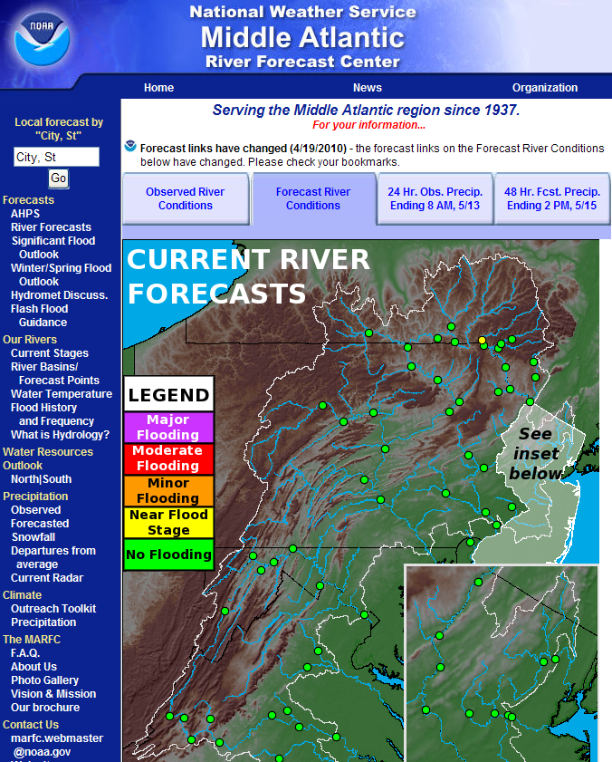
http://weather.gov/marfc
Notes:
The Middle Atlantic River Forecast Center is one of 13 National Weather Service River Forecast Centers. We are located in State College, PA and serve the Susquehanna, Delaware, Passaic, Raritan, Potomac, Rappahannock and James water sheds.
Our homepage is weather.gov/marfc
Other River Forecast Centers serving the Eastern United States are:
Northeast http://weather.gov/nerfy
Ohio http://weather.gov/ohrfc
Southeast http://weather.gov/serfc
Lower Mississippi http://weather.gov/lmrfc

Slide 22
Flash Flood Guidance
Amount of rain needed to push small streams out of their banks
Helpful in situational awareness – how much rainfall can we handle?
Notes:
Look on the left hand column on the Middle Atlantic River Forecast Center’s website for the link to Flash Flood Guidance. This guidance is helpful to get an indication of how much rain is needed to bring small streams out of their banks. It is important to remember that any new rain occurring after the Guidance was issued, needs to be taken into account when using these values.

Slide 23
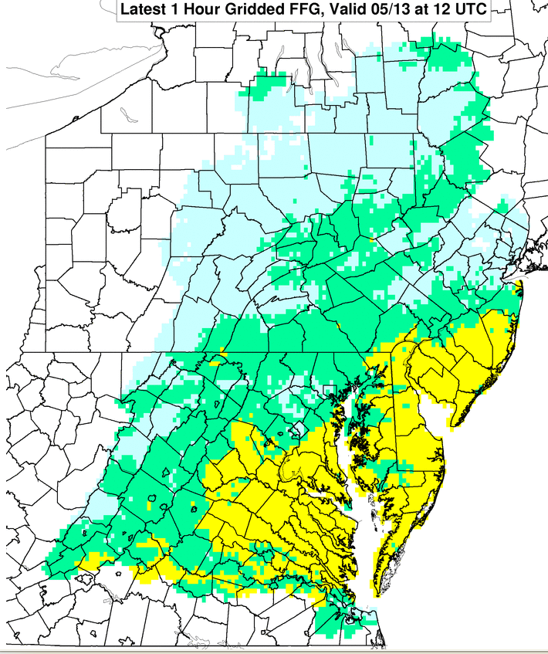
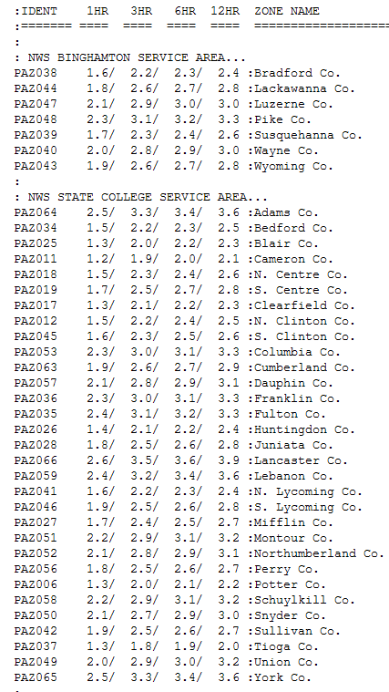
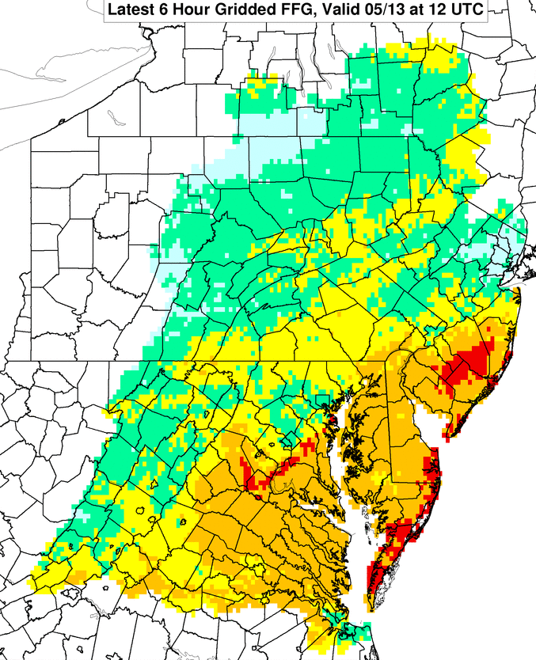
Notes:
Flash Flood Guidance (FFG) provides a general indication of the amount of rainfall evenly distributed over various durations (in hours), necessary to cause small streams to overflow their natural banks. During heavy rainfall, accurate interpretation of the guidance consists of the combination of rainfall that has already occurred plus any additional rainfall that can be confidently expected to fall over the same location in the immediate future.
It should be noted that FFG values represent an estimate of average soil moisture and stream flow conditions in a given county. Flooding may occur with less rainfall than indicated in areas where recent rain has been locally heavier. In addition, during prolonged dry spells, soils may temporarily have impervious characteristics at the onset of heavy rain, resulting in extra runoff and possible flooding from lower rainfall amounts than those indicated by the FFG.
The data is provided in a gridded format in 1, 3 and 6 hr increments. This website also has a link to a tabular listing by county of the 1, 3, 6 and 12 hr Flash Flood Guidance values.

Slide 24
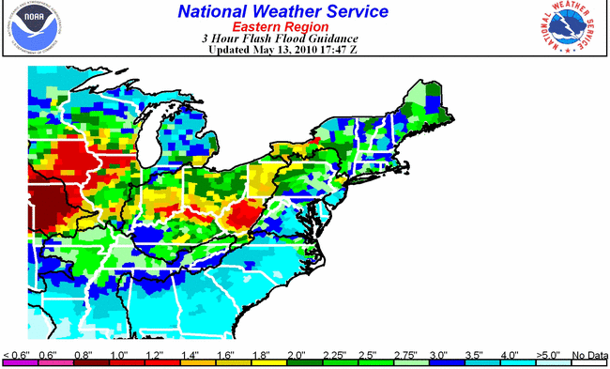
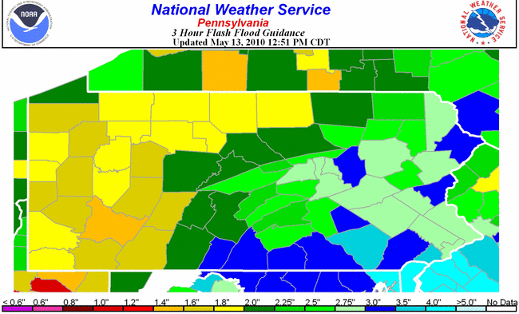
Notes:
County-averaged flash flood guidance maps on a regional, state or river forecast center area are available at: http://www.srh.noaa.gov/rfcshare/ffg.php?duration=3&location=ERN
You can also download the data for use in GIS applications from this website.

Slide 25
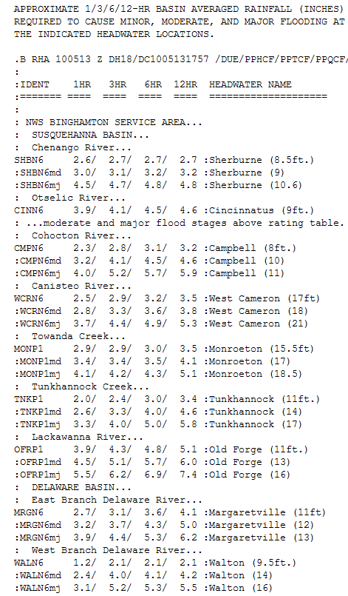
Headwater Guidance
Specific to a particular stream location with:
USGS stream gage
Official established NWS Flood Stage
Notes:
Headwater Flood Guidance depicts the approximate rainfall evenly distributed over various durations to cause selected streams to reach official NWS flood stage (may not necessarily coincide with the natural bank) at U. S. Geological Survey gauging stations. As with Flash Flood Guidance, these values are intended as general guidance.

Slide 26
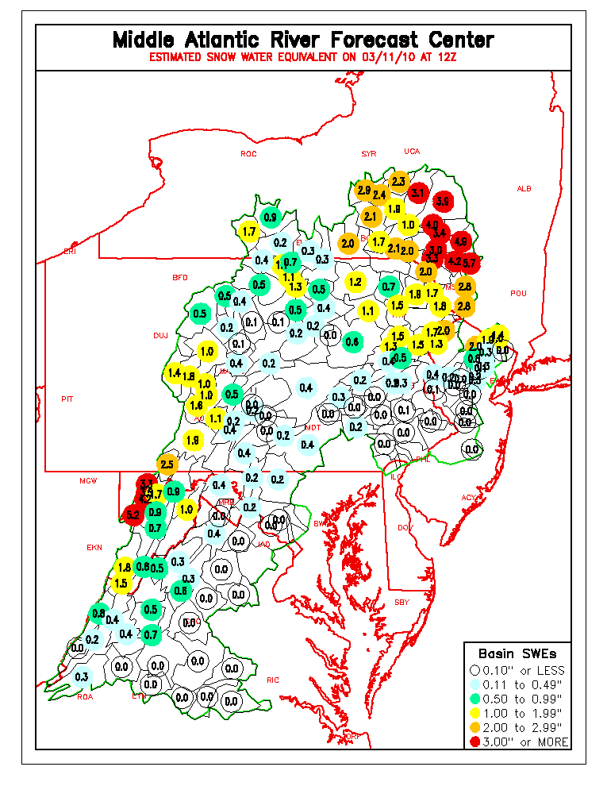
Snow Water Equivalent
Notes:
Snow water equivalent is the amount of water held in the snowpack. MARFC provides basin-average and county-average maps. Just click on the Snowfall link on the left menu. These maps are updated every morning. Our estimated amounts are compared to field observations made by the NWS Weather Forecast Offices, and NYC DEP and also to satellite estimates made by NOHRSC.
Snow Water Equivalent is important to know during rain and snowmelt events. The additional runoff produced by snowmelt may cause more significant flooding.

Slide 27
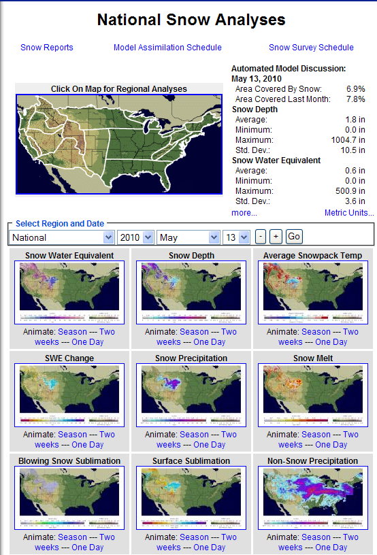
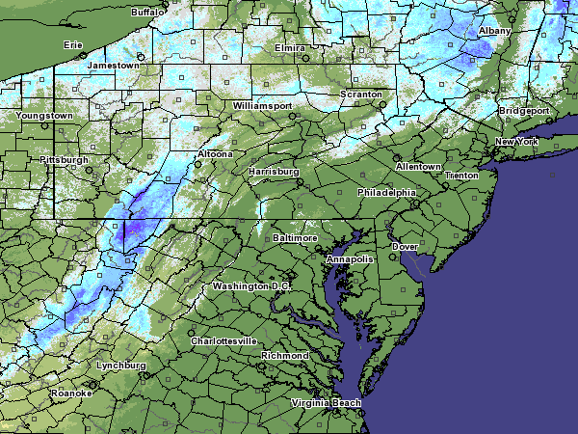
Notes:
An example of a SWE plot available through the NOHRSC website. NOHRSC has many other datasets that you might be interested in: snow depth, snowpack temperature (let’s you know how ready the pack is to melt), snow melt, etc..

Slide 28
Flood Outlook Product
Notes:
Updated daily, the Flood Outlook product highlights areas where moderate or major flooding are possible through the next 5 days.

Slide 29
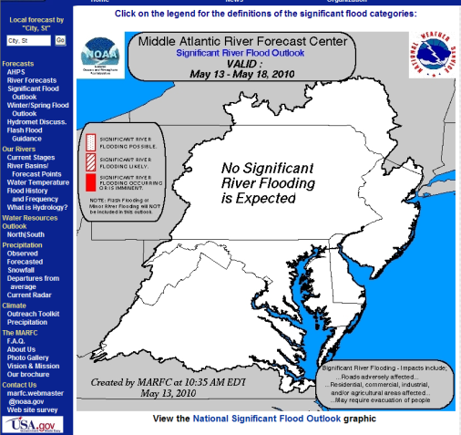
National Flood Outlook
Notes:
The national product is a compilation of all River Forecast Center’s individual Flood Outlook Products. It is updated daily, around 5pm.

Slide 30
See our handout for the addresses to these and other helpful NWS internet sites.
erik.heden@noaa.gov
patricia.wnek@noaa.gov
Notes:
See separate handout that will be provided at the conference. If you have any questions, or need a handout emailed to you, please don’t hesitate to email Patti or Erik.

